Slide 1
Taking India to MARS
The Story behind India’s space programme
Tedx video by Ritu karidhal
Deputy Operations directions

Slide 2
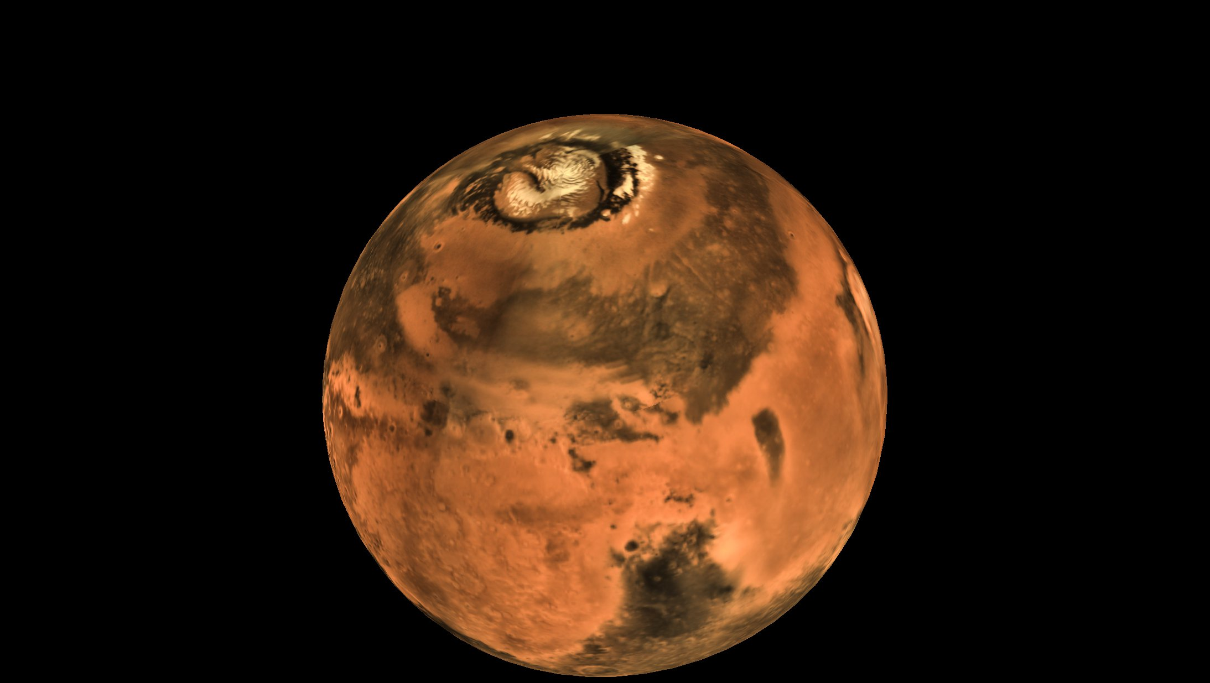
MOM
Mars Orbiter Mission

Slide 3
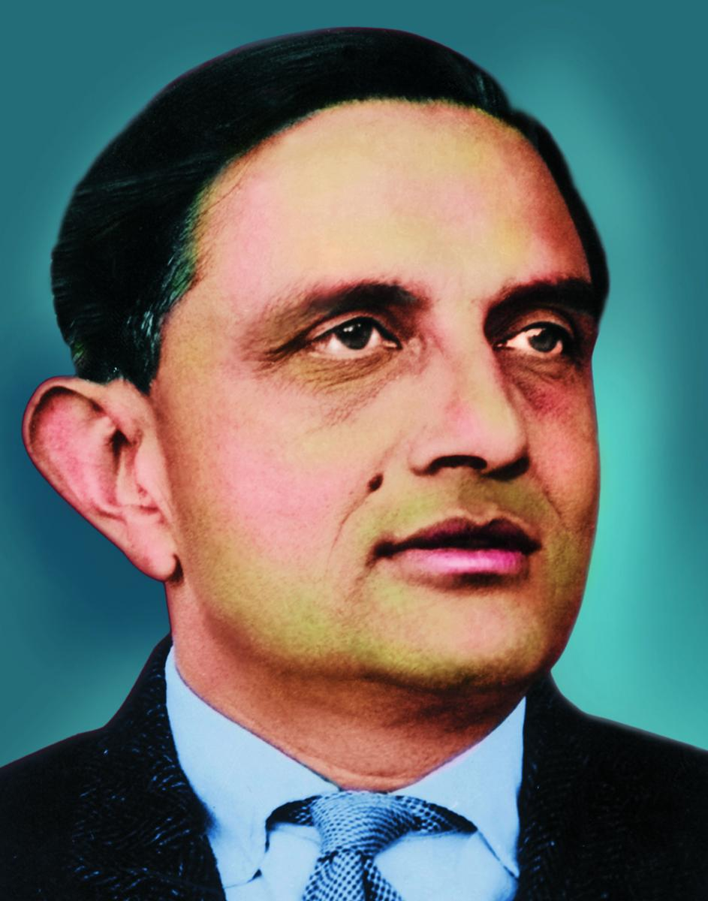
History
ISRO
Dr. Vikram Sarabhai
1960

Slide 4
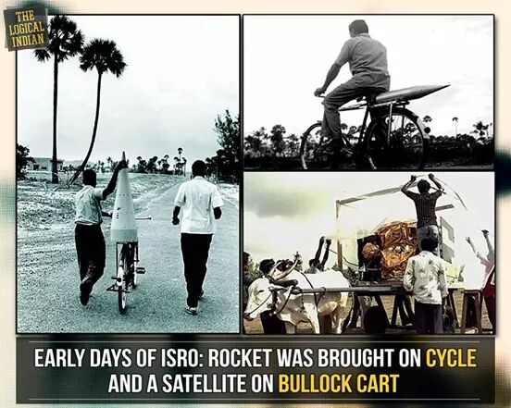
Earlier Days

Slide 5
Facts about Mars
Min distance - 54.6 million km
Max distance – 401 million km
Year span- 687 earth days
2 satellites- Phobos and Deimos
Size is half of the earth

Slide 6
Facts about MOM
Total travelled distance – 650 millions km
Min fuel used
First interplanetary mission for ISRO
First mission- First attempt success
Min cost- ₹ 4.5 billion

Slide 7
Conclusion
We, the Indians, no longer are behind
from anybody from the west.
Feel PROUD.

